Slide 1



Students:
Ahmad Fadel AlDababseh
FullStack PHP WebDevelopment
Coh_9
2022/2023
____________________________
Supervisor:
Bisharah Estephan
جامعة الحسين التقنية
Al Hussein Technical University
H.T.U

Slide 2


Outline
Introduction
Related Work
Problem Statement
Methodology
Design Models
Demo

Slide 3

Introduction
This chapter explains the problems with the current system that led us to create a website that addresses these issues, as well as the objectives of the new system and the methodology that will be used.

Slide 4
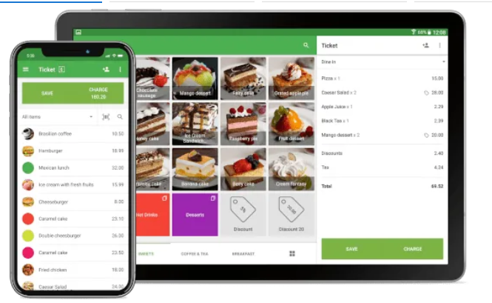
Related Work
1. Loyverse Customer Display app
This application can issue electronic receipts, apply discounts, issue refunds, continue to record sales even when offline, connect a receipt printer, barcode scanner, cash drawer, and accept any payment method you want. Select one of our integrated payment providers, available in more than 30 countries. Integrated payments saves time, ensures better accuracy, and reduces errors Your preferred merchant service provider can be used for non-integrated payments
In terms of inventory management, inventory does not run out. Track real-time inventory levels Receive automatic low stock alerts Send orders to suppliers Track inventory receipts Transfer inventory between your stores Print barcode labels.

Slide 5
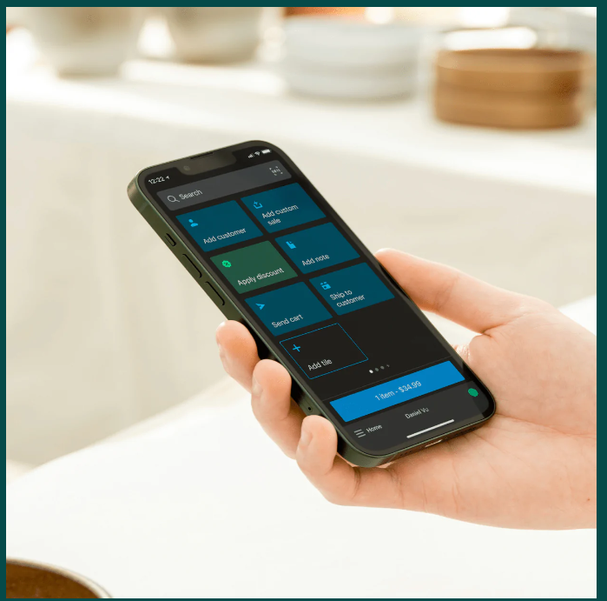
Related Work
2. Shopify
Powerful POS software Turn any mobile device into a powerful point of sale. You can download the Shopify Retail POS app on to any Android or iOS smartphone or tablet. Customizable POS terminal
Personalize your POS system to your business. Keep your most-used apps, discounts, and products at your fingertips so you can fly through checkout.Fully integrated hardware
Get the perfect POS setup, whether you’re a pop up shop or a retail store. Shopify POS connects seamlessly with Shopify card readers and compatible hardware accessories

Slide 6

Problem Statement
Due to the ineffectiveness of the manual system in counting sales, to reduce the error rate, and to avoid problems in counting the quantities available in the store, the manual system was dispensed with and replaced with modern electronic systems.

Slide 7
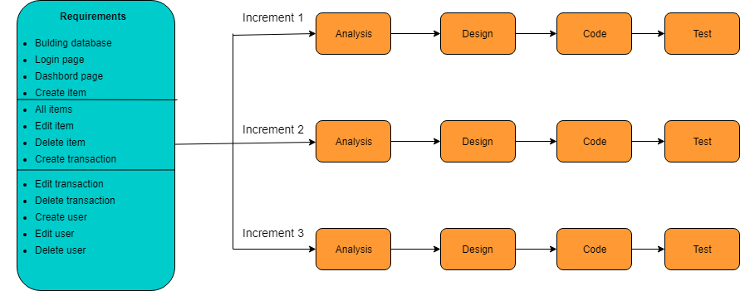
Methodology Process
Incremental Model

Slide 8
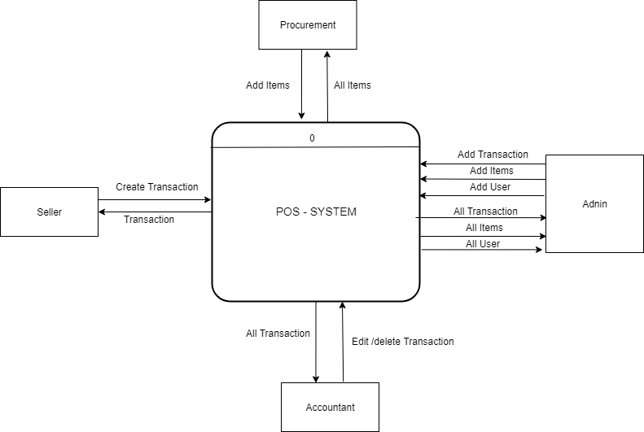
Design Model
Context Diagram

Slide 9
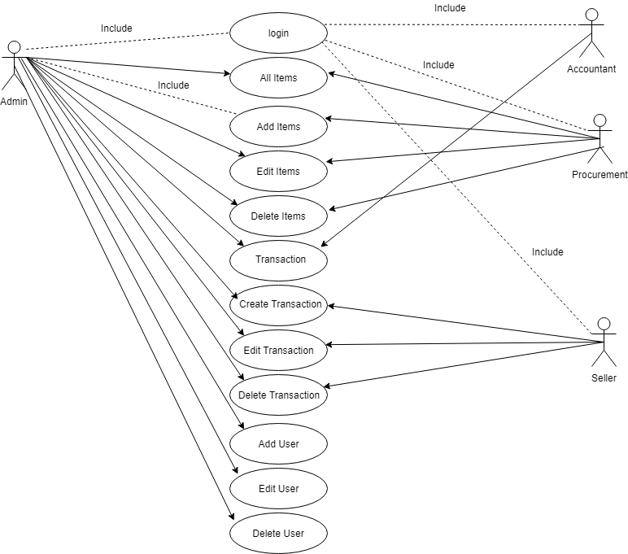
Design Model
Use Case Diagram

Slide 10
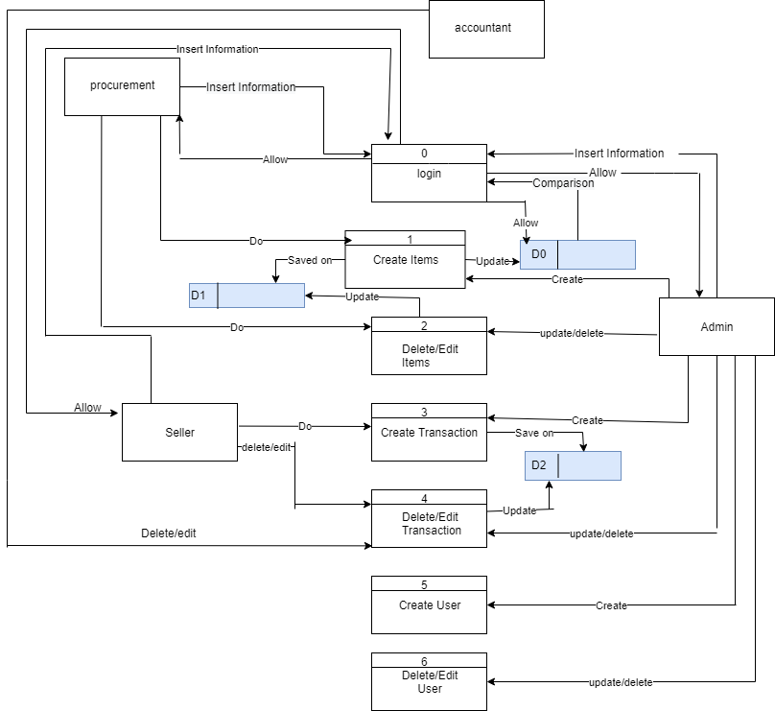
Design Model
Data Flow Diagram

Slide 11
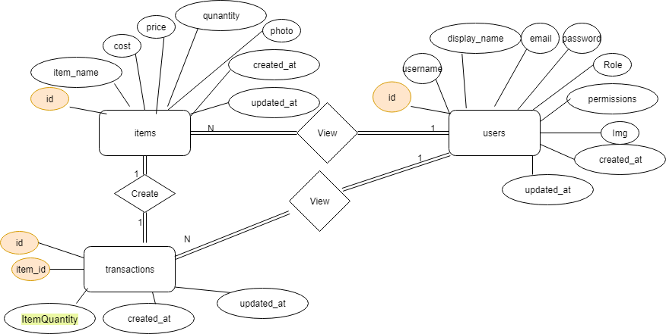
Design Model
ER Diagram

Slide 12
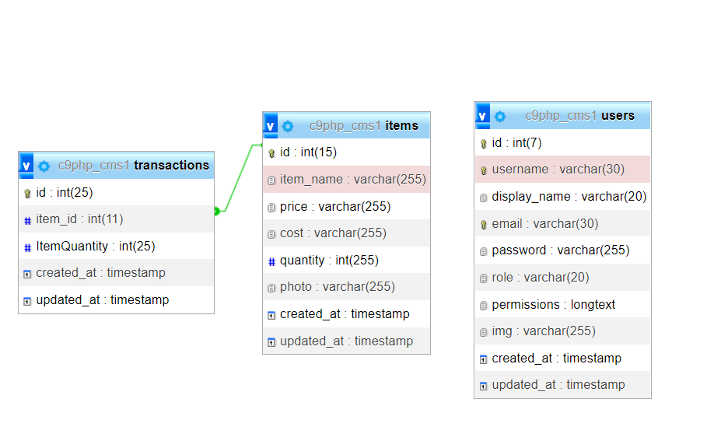
Design Model
Schema Diagram

Slide 13
Thanks for following up.

